Slide 1
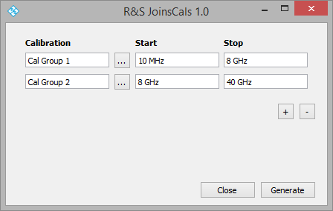
R&S Join Cals Macro
User provides start, stop frequency to use when combining calibrations
Add/Remove cal group
Generate new calibration by joining the calibrations above at the specified start/stop frequencies
Cancel, close window

